Slide 1

Course Name: Hardware Security
Faculty Name: Prof Debdeep Mukhopadhyay
Department : Computer Science and Engineering
Topic
Lecture 01: Introduction to Hardware Security (Part-1)

Slide 2

Concepts Covered:
Cryptology, and Hardware Security
Hardware Accelerators
Bottlenecks of Von-Neumann Architecture
Design-for-Security

Slide 3


Cryptology
Objectives: Aims at design and analysis of algorithms to ensure:
Confidentiality
Integrity
Availability
Recent days there has been humongous advancement in cryptology.
New primitives developed giving us additional capabilities:
Performing operations on encrypted databased in cloud.
Post-quantum Cryptography, etc.
“if you think your problem can be solved by cryptography, then you do not understand cryptography and you do not understand your problem”-[Bruce Schneier]
PIP for Faculty

Slide 4
Need for Hardware Accelerators for Cryptology
Hardware vs Software speeds:
Sensitive operations in the internet is becoming very important aspect of web applications.
E-commerce and net-banking require transfer of sensitive information and are protected by Secure Socket Layer (SSL) and Transport Layer Security (TLS) protocols.
Open SSL is an open source implementation of SSL and TLS, and accompanying cryptographic algorithms.
OpenSSL has implementations of symmetric ciphers, asymmetric ciphers, hash functions, etc.
However, they are time consuming in software!
PIP for Faculty

Slide 5
Cryptographic Co-processors
Cryptographic algorithms can be accelerated by providing customized instruction in the processor Instruction Set Architecture (ISA):
AES-NI: Special Instruction in Intel ISA for performing AES operations.
PCLMULQDQ: Special Instruction in Intel ISA for carry less multiplication of 2 64-bit operands.
Advantages:
Speed: Hardware offers speed, dedicated processing, parallelism.
Security: Can rule out many attacks which are possible on pure software.
PIP for Faculty

Slide 6
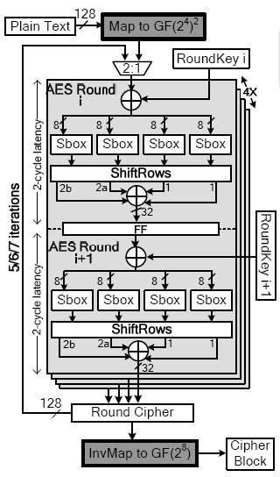
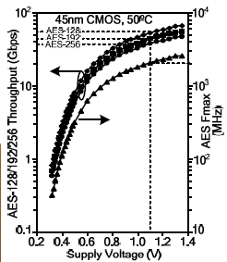
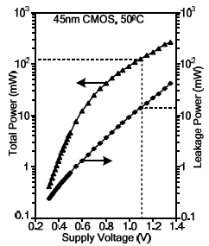
Intel’s AES-NI: Instruction for AES Operations
Reference: S. Mathew, 53Gbps Native GF(2⁴⁾² Composite Field AES-Encrypt/Decrypt Accelerator for Content Protection in 45nm High Performance Microprocessors,VTS 2010
PIP for Faculty

Slide 7
A Case Study of ECC Co-processors
Elliptic Curve Cryptography (ECC) is an efficient public key cipher.
Elliptic Curve Scalar Multiplication
Scalar (x)
Scalar Product (xP )
Base Point (P)
ECC Scalar
Multiplier
Reference: https://www.youtube.com/watch?v=2RVLBUncHJk&list=PL71FE85723FD414D7&index=34
PIP for Faculty

Slide 8
A Case Study of ECC Co-processors (Contd.)
Elliptic Curve Cryptography (ECC) is costly:
For n-bit key for characteristic 2 curves (n could be 163 or 233), number of finite field operations are roughly:
#Inv: 2n, #Mul: 2n, #Add: 4n, #Sqr: 2n (for affine co-ordinate implementations).
On Intel Core II Duo with 2.93 GHz and OpenSSL 1.0.1c, average time for 10000 scalar multiplications is 8.891 s.
A hardware accelerator prototyped on Altera Cyclone IV FPGA requires around 4.397 s (double speed up!)
Reference: Debapriya Basu Roy, Shubham Agrawal, Chester Rebeiro, Debdeep Mukhopadhyay:
Accelerating OpenSSL's ECC with low cost reconfigurable hardware. ISIC 2016: 1-4
PIP for Faculty

Slide 9
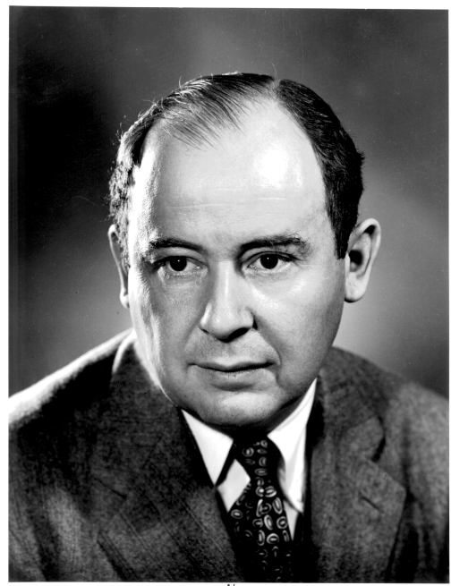
Hardware to Enhance Security
Software Attacks: Present day computing systems are naturally vulnerable.
MEMORY
HIERARCHY
CONTROL
Program
Counter
INPUT
REGISTERS
ALU
OUTPUT
Von Neumann (1903-1957)
Contributed to give a very basic model, often referred to as Von Neumann model
MEMORY
CPU
I/O BUS
MEMORY BUS
PIP for Faculty

Slide 10
Stored Program
Programs are sequence of instructions stored in the memory.
The CPU consists of:
Program Counter (PC) indicates the address of the next instruction to be executed.
ALU (Arithmetic Logic Unit)
performs arithmetic and logical operations
Registers: High Speed storage of operands.
Control Unit: That interprets instructions and causes them to be executed.
Memory: Memory has several hierarchy
PIP for Faculty

Slide 11
Stored Program and bottle-necks
The memory stores the instructions, data and intermediate results. Memory has several hierarchy:
registers being the highest level and the fastest form.
Input/ Output: Transmits and receives results and messages (information) from and to the outside world respectively.
How do you know 0x90ABCD is a code or data?
The OS (software) does not know? ☹
Because of the shared memory bus, there is a bottleneck called memory wall:
The memory is much slower compared to the CPU speed.
Fast memories called cache, branch-predictions have been developed.
PIP for Faculty

Slide 12
Software Attack Example: Buffer Overflow
#include <stdio.h>
void callfunc()
{
int buf[3];
int *ret;
ret = buf + 5;
*ret = *ret + 7;
}
void main( )
{
int b;
b = 0;
callfunc();
b = 1;
printf("%d\n", b);
}
Outline of the Attack:
It may be noted that the program should not have any effect on the output of the printf function in main.
The printf function should display the value of the local variable b as 1.
However the callfunct changes the return address and makes the control of the program to skip the assignment of x=1.
Thus the program prints 0, while it should print 1.
Reference: Aleph One, Smashing the Stack for fun and Profit.
PIP for Faculty

Slide 13
The stack’s snapshot
buf
*ret
sfp
return
address
12 bytes
4 bytes
4 bytes
Thus, buf+20 points to the content in the stack, where the return address is stored.
PIP for Faculty

Slide 14
Skipping the line x=1
The address values are obtained using the gdb tool
The output of which is provided next.
We observe the assignment x=1 marked in yellow.
It is evident from the output of the gdb tool, that the return address needs to be increased by 7, the difference between the memory locations 0x080483ff and 0x08048406.
Dump of assembler code for function main:
0x080483e2 <main+0>: lea 0x4(%esp),%ecx
0x080483e6 <main+4>: and $0xfffffff0,%esp
0x080483e9 <main+7>: pushl 0xfffffffc(%ecx)
0x080483ec <main+10>: push %ebp
0x080483ed <main+11>: mov %esp,%ebp
0x080483ef <main+13>: push %ecx
0x080483f0 <main+14>: sub $0x24,%esp
0x080483f3 <main+17>: movl $0x0,0xfffffff8(%ebp)
0x080483fa <main+24>: call 0x80483c4 <callfunc>
0x080483ff <main+29>: movl $0x1,0xfffffff8(%ebp)
0x08048406 <main+36>: mov 0xfffffff8(%ebp),%eax
0x08048409 <main+39>: mov %eax,0x4(%esp)
0x0804840d <main+43>: movl $0x8048500,(%esp)
0x08048414 <main+50>: call 0x80482dc <printf@plt>
0x08048419 <main+55>: add $0x24,%esp
0x0804841c <main+58>: pop %ecx
0x0804841d <main+59>: pop %ebp
0x0804841e <main+60>: lea 0xfffffffc(%ecx),%esp
0x08048421 <main+63>: ret
End of assembler dump.
PIP for Faculty

Slide 15
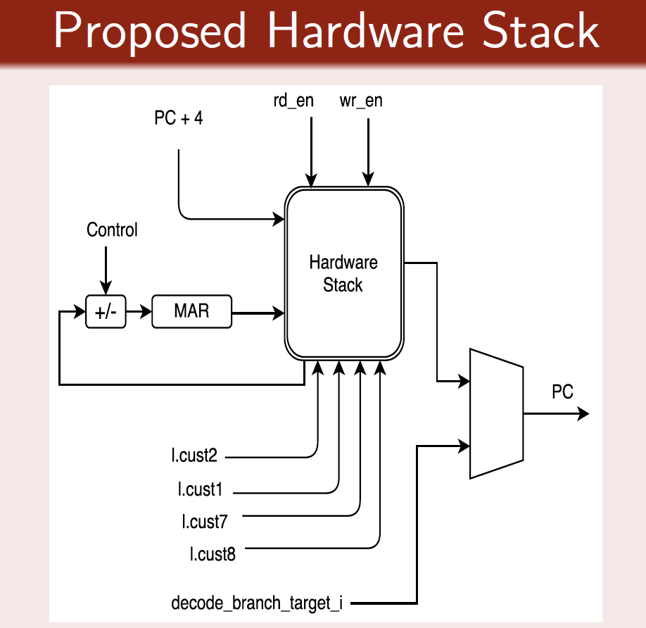
Hardware Mitigation of Buffer Overflow
Hardware Stack stores the function return address:
Whenever it encounters a l.jal or l.jalr instruction, it pushes the next program counter value to the stack.
Alternatively, if it encounters l.jr with register r9 as parameter, it pops its top value and passes that as the return address.
Custom instructions:
l.cust7: when enabled, the return address of the functions are read from hardware stack
l.cust8: Freezes the hardware stack
l.cust1: Unfreezes the hardware stack
l.cust2: Disables the hardware stack
PIP for Faculty

Slide 16
Attacks due to Memory Wall
Microprocessor
Cache Memory
Main Memory
If there is a Cache Hit
Access time is less
Power Consumption is less
If there is a Cache Miss
Access time is more
Power Consumption is more
PIP for Faculty

Slide 17
Timing Attacks due to Cache Memory
Uses a spy program to determine cache behavior
Cache Memory
Part of the cache memory occupied by tables
Microprocessor
Cache Miss
Cache Hit
AES
Spy
Memory

Slide 18
Micro-architectural Attacks: Design for Security
Computer Architecture has been designed with performance as a primary design criteria.
Security has been an after thought.
For example:
Speculative execution is an optimization technique where a computer system performs some task that may not be needed.
This has been the basis of the recently discovered attacks: Spectre and Meltdown.
To quote Bruce Schneier, “Fixing them either requires a patch that results in a major performance hit, or is impossible and requires a re-architecture of conditional execution in future CPU chips. It shouldn't be surprising given that microprocessor designers have been building insecure hardware for 20 years. What's surprising is that it took 20 years to discover it."
Reference: Spectre and Meltdown, Daniel Gruss, Moritz Lipp, Yuval Yarom, Paul Kocher, Daniel Genkin, Michael Schwarz, Mike Hamburg, Stefan Mangard, Thomas Prescher and Werner Haas, Google Ground Zero Project

Slide 19
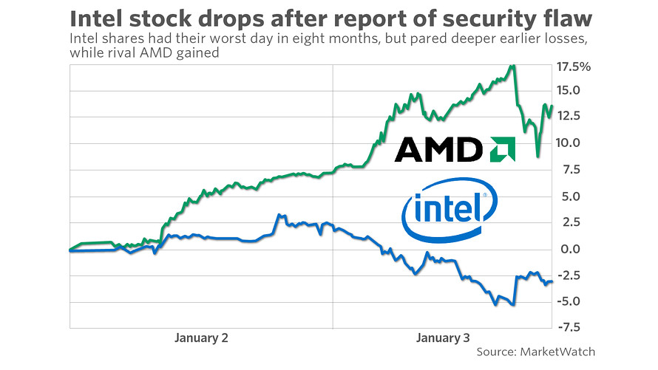
Security can be a game changer
Although the vulnerabilities, called Meltdown and Spectre, affected leading processors in many devices, Intel is bearing most of the fallout after rival AMD distanced itself from the bulk of the issues. Intel shares were down nearly 5 percent, around $43 apiece, after posting a 3 percent decline on Wednesday.
Reference: https://www.cnbc.com/2018/01/04/intel-stock-down-intc-could-meltdown-spectre-exploit-benefit-amd.html

Slide 20

Conclusion:
Hardware Security has profound influence on modern day.
Hardware provides opportunity to accelerate cryptographic operations
Security Bottleneck in Von-Neumann Architecture and
Micro-architectural Attacks
Design-for-Security

Slide 21


